Slide 1
NASSCOM –
Advanced DATA Analytics
GROUP - IV
Credit Card Fraud – An Introduction and Detection

Slide 2
Introduction to R Programming
01
Introduction to Credit Card Frauds
02
Implementing Sophisticated Methods
03
Index
Conclusion and References
04

Slide 3

INTRO
TO
R Programming
R is a free software environment for statistical computing and graphics.

Slide 4
R Programming
Open Source
Program Independent
R is an open-source language and can be downloaded from CRAN servers We can contribute to the development of R by optimizing our packages and resolving issues.
CRAN servers
R is a platform-independent language or cross-platform programming language which means its code can run on all operating systems.
CRAN is a network of ftp and web servers around the world that store identical, up-to-date, versions of code and documentation for R.
Machine Learning Operations
Packages
R has over 10,000 packages in the CRAN repository which are constantly growing which is for data science and machine learning operations.
R allows us to do various machine learning operations such as classification and regression. R is used by the best data scientists in the world.
Plots and Graphs
Data Wrangling
R provides packages such as dplyr, readr which are capable of transforming messy data into a structured form.
R simplifies quality plotting and graphing. R libraries such as ggplot2 and plotly advocates for visually appealing and aesthetic graphs which set R apart from other programming languages.

Slide 5
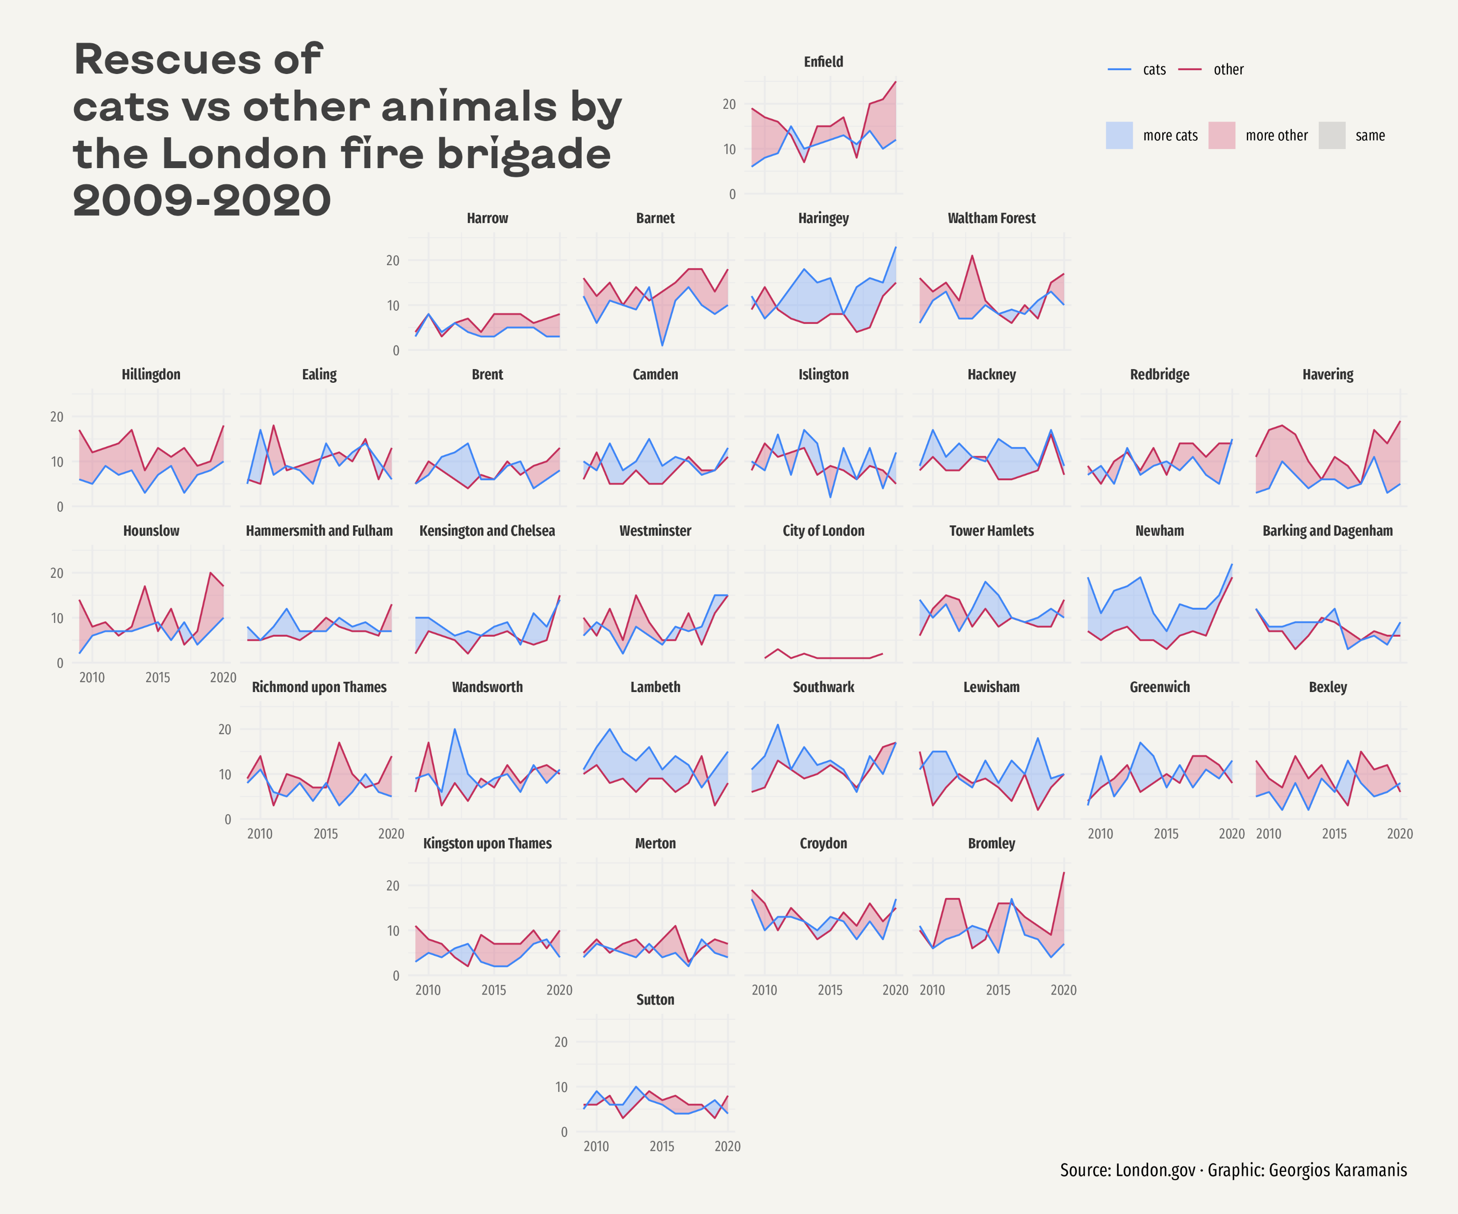
This dashboard was made with R Shiny along with ggplot2.
R Shiny is a add-on library that helps us to create visually attractive dashboards.

Slide 6
Introduction
To Credit Card Fraud

Slide 7
Credit Card Fraud
Credit card fraud is a term for fraud committed using a payment card, such as a credit card or debit card whose purpose may be to obtain goods or services or to make payment to another account, which is controlled by a criminal.
Credit card fraud can be authorized, where the genuine customer themselves processes payment to another account which is controlled by a criminal, or unauthorized, where the account holder does not provide authorization for the payment to proceed and the transaction is carried out by a third party.
Credit Card Fraud
In 2018, unauthorized financial fraud losses across payment cards and remote banking totaled £844.8 million in the United Kingdom. Whereas banks and card companies prevented £1.66 billion in unauthorized fraud in 2018.
The technology and security measures behind credit cards are becoming increasingly sophisticated making it harder for fraudsters to steal money. But nonetheless, criminals and hackers are coming up with new and innovative ways to siphon and steal money from the card.

Slide 8
Credit Card Fraud And its Types
Keystroke Logging
PoS Fraud
Since most financial transactions are online, hackers have started relying on keystroke logging through malicious software to grab credit card details. This usually begins after you have clicked on a suspicious link and unknowingly installed malware on your system. The software records every key pressed on the system, eventually stealing card details, PIN and more.
Small skimming devices are attached to normal Point-of-Sale (PoS) devices to hack your data. These devices scan and store the card information while the customer completes a swipe transaction. Similar attachments may also be fastened on to ATM card slots to clone card information, while a camera is secretly placed over the keypad to capture PIN.
Application Fraud
Phishing and Vishing
This is a type of identity theft where fraudulent actors impersonate a genuine customer by using their stolen or counterfeited documents to obtain a credit card. While this might be detected after thorough background checks, if carried out, this will allow criminals to use a valid credit card with a false paper trail. A similar type of fraud involves taking over a valid credit card account by posing as the customer using a similar fake paper trail.
These involve impersonating official communication from the bank which in turns acts as a bait for you to click on false links. This will usually take you to websites that look authentic. Once you enter your card details on these fake links, fraudsters can access the details and use them for their benefit. Another version is when fraudsters impersonate bank officials on phone calls, asking you to share an OTP to ‘verify your card’ or ‘avail the reward points’ or ‘extend the validity of your reward points.’

Slide 9
Implementation
The technology and security measures behind credit cards are becoming increasingly sophisticated making it harder for fraudsters to steal money. But nonetheless, criminals and hackers are coming up with new and innovative ways to cheat and make a fool out of the customers.
Before we try to stop it, we must first detect it because there is a condition that the customer might be in an emergency situation so he needs to withdraw more money.
We have tried to implement this by 3 different ways:
Logistic Regression (LR)
Artificial Neural Networks (ANN)
Decision Trees

Slide 10
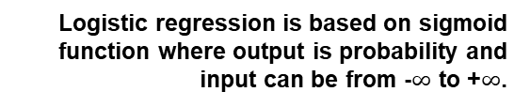
Logistic Regression
When is Logistic Regression used?
Logistic regression in R Programming is a classification algorithm used to find the probability of event success and event failure. Logistic regression is used when the dependent variable is binary(0/1, True/False, Yes/No) in nature. Logit function is used as a link function in a binomial distribution.
What is Logistic Regression?
Logistic regression is one of the techniques in machine learning used to form prediction models.
It is one of the most popular classification algorithms mostly used for classification problems.
Logistic Regression is used when the dependent variable(target) is categorical.)
Sigmoid Function
Logistic regression is based on sigmoid function where output is probability and input can be from -$∞$ to +$∞$.
Logistic Regression
Model Evaluation
Model is evaluated using the Confusion matrix, AUC(Area under the curve), and ROC(Receiver operating characteristics) curve. In the confusion matrix, we should not always look for accuracy but also for sensitivity and specificity. ROC and AUC curve is plotted. designed.

Slide 11
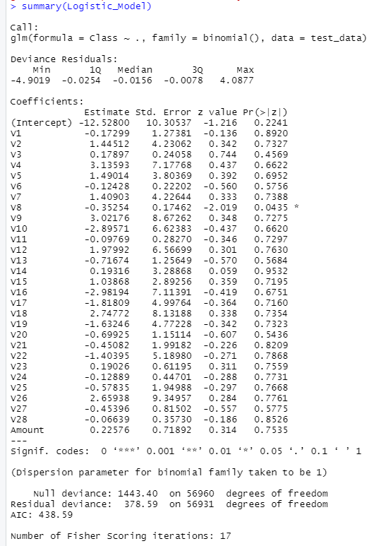
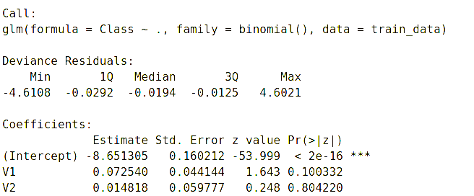

Slide 12
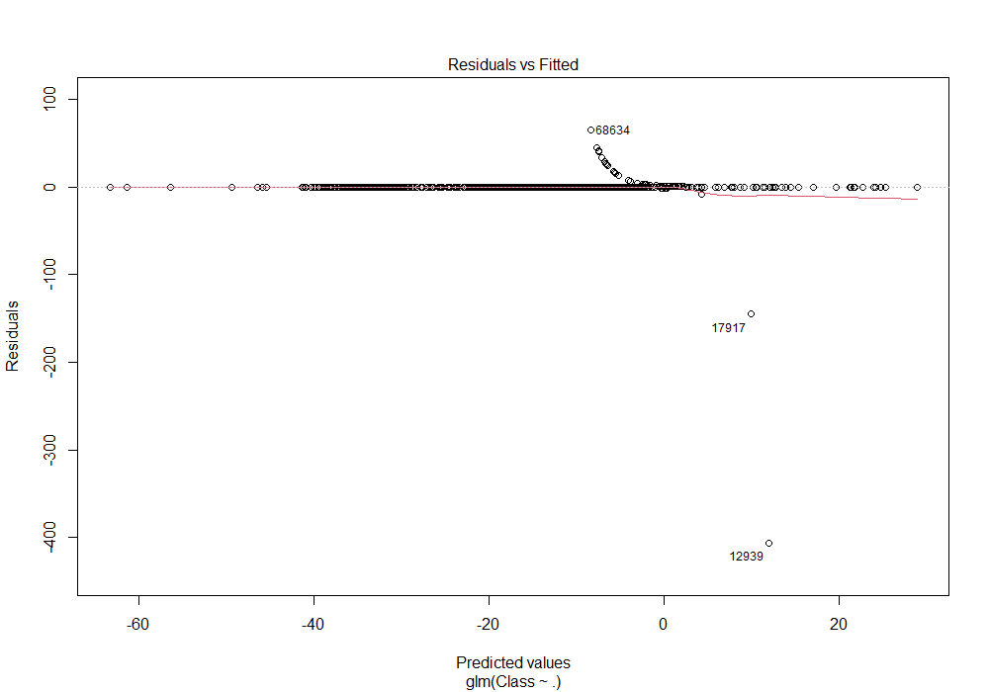
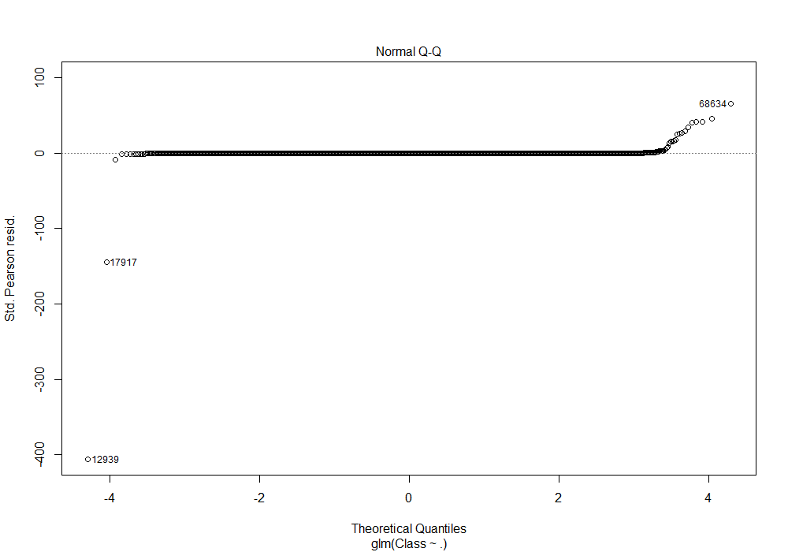
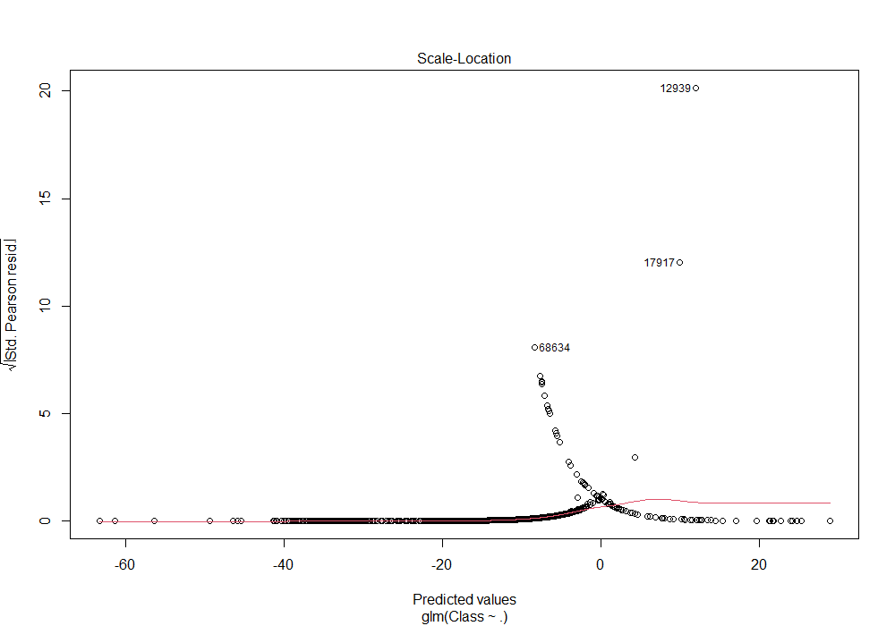

Slide 13
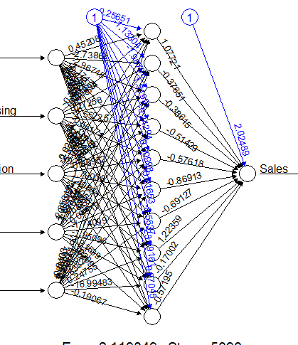
Neural networks are built from units called Perceptrons. Perceptrons have one or more inputs, an activation function and an output. An ANN model is built up by combining them in structured layers. They are independent of each other, but the each connect to all the Perceptrons in the next layer.
The input layer contains a Perceptrons for each predictor variable and one or more hidden layers contain a user defined number of Perceptrons. Each Perceptrons in the first hidden layer receives an input from the each Perceptrons in the input layer. If there is a second hidden layer, each Perceptrons in this layer receives an input from each Perceptrons in the first hidden layer, and so on with additional layers.
The output layer contains a Perceptron for each response variable (usually one, sometimes more in multivariate response situations). Each output Perceptron receives one input from each in the final hidden layer
They have a nonlinear activation which determines their output value based upon the values of their inputs.
ARTIFICIAL NEURAL NETWORKS

Slide 14
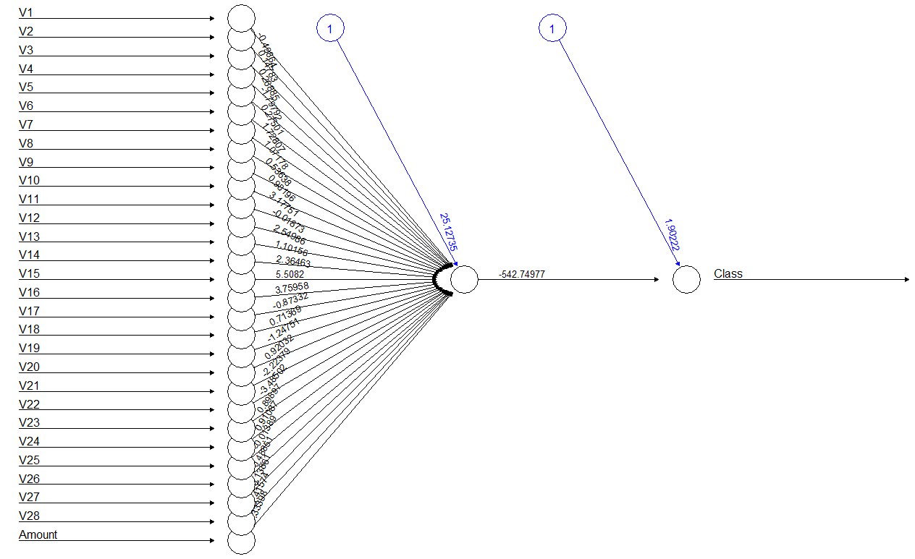

Slide 15
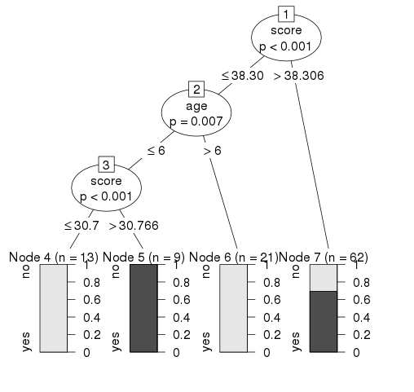
DECISION TREES
Decision tree is a graph to represent choices and their results in form of a tree. The nodes in the graph represent an event or choice and the edges of the graph represent the decision rules or conditions.
It is mostly used in Machine Learning and Data Mining applications using R.
Advantages of Decision Trees
Easy Interpretations and Predictions
01
Simple to understand and to interpret. Trees can be visualized.
Handling Missing Data
02
Missing values in the data also do not affect the process of building a decision tree to any considerable extent.
Identifying Variables
A decision tree does not require normalization of data and scaling as well. Compared to other algorithms decision trees requires less effort for data preparation during pre-processing.
03

Slide 16
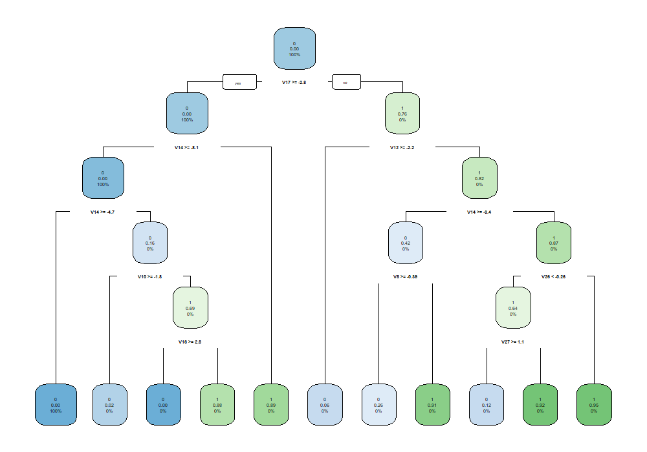

Slide 17
THANK YOU!
From:- Group IV
SAGAR C BELLAD – 19BAI10183
FAIZAN MIRZA – 19BAI10157
RAJAT KAUSHIK – 19BAI10110
ASHWIN R – 19BAI10132
HARDIK MAHTO – 19BAI10126
VIGNESH M – 19BAI10107
HARSHAVARDHAN J – 19BAI10009
SATVIK SHETTY – 19BAI10051
ANANYA MAHAPATRA – 19BAI10061
VIKANSH GAUTAM – 19BAI10024
SNEHIL SHARMA – 19BAI10134

Slide 18
References
https://www.axisbank.com/progress-with-us/managing-credit/what-are-the-types-of-credit-card-frauds-in-india
https://en.wikipedia.org/wiki/Credit_card_fraud#Means_of_payment_card_fraud
https://rpubs.com/julianhatwell/annr
https://www.r-bloggers.com/2021/04/decision-trees-in-r/
https://www.datacamp.com/community/tutorials/logistic-regression-R

